Slide 1
Federalism & The Division of Powers

Slide 2
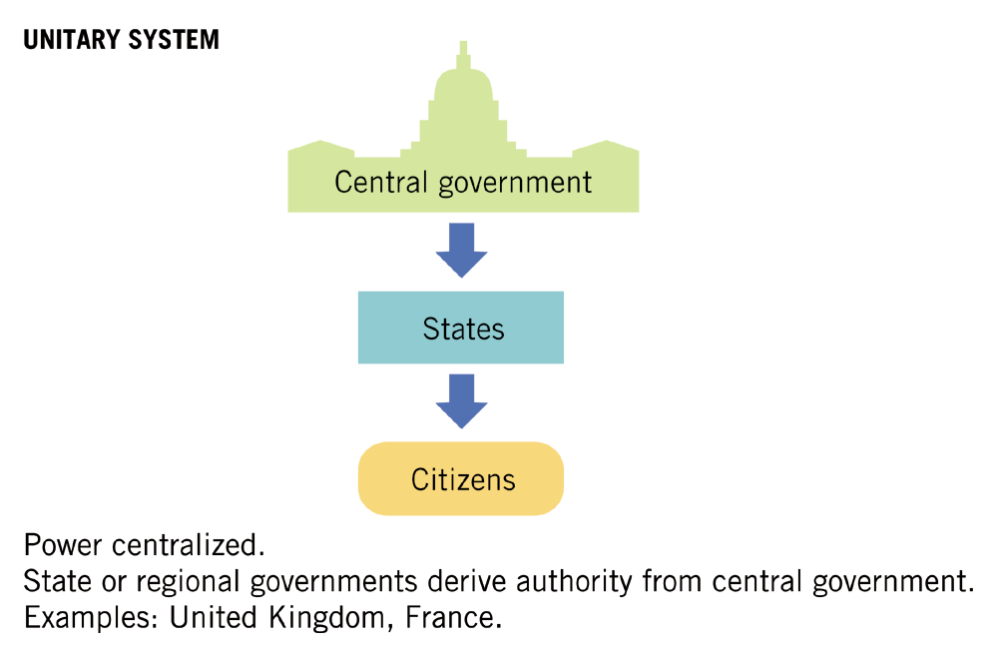

Slide 3
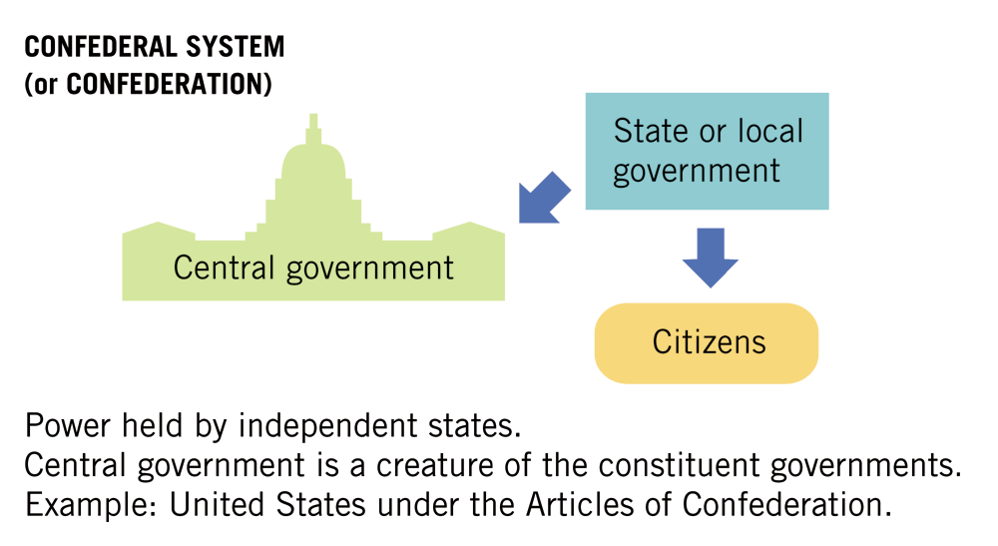

Slide 4
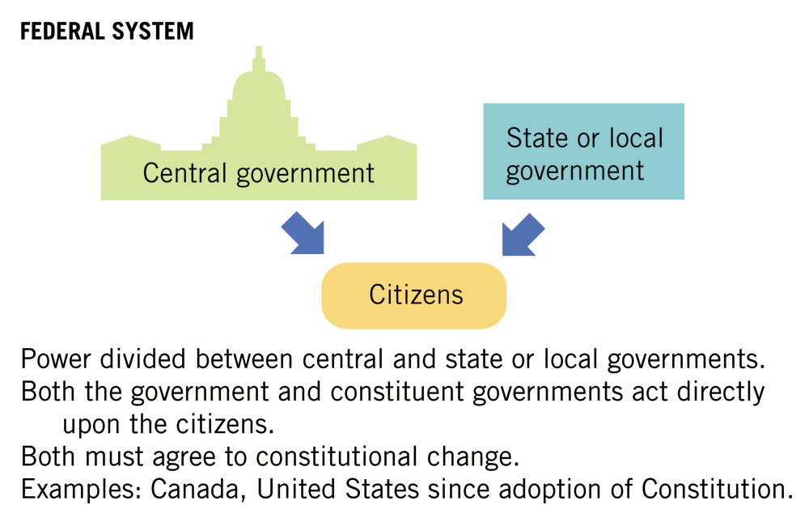

Slide 5
Why Federalism?
Shared resources
States know needs of people
Allows unity without uniformity
Protects against a runaway federal government
Encourages experimentation
Allows states to administer federal programs
Allows states to cooperate with each other
Equalizes financial resources

Slide 6
Types of Powers in a Federal System
Delegated Powers – three distinct types of powers granted to the national government by the Constitution:
Enumerated Powers (or Expressed) – Article I, Section 8
Implied Powers – Article I, Section 8, Clause 18 (Elastic Clause/Necessary & Proper Clause
Inherent Powers – self-evident powers
Concurrent Powers (Federal and State governments)
Reserved Powers (States) – 10th Amendment
Prohibited Powers – Article 1, Section 10

Slide 7
Dual Federalism v. Cooperative Federalism
Layer Cake
Marble Cake

Slide 8
Who is the Referee?
Article VI, Section II of the Constitution
The Supreme Court is the judge in determining whether the federal government can intervene in the way states regulare their citizens.
Landmark Cases decided by the Supreme Court dealing with federal supremacy:
McCulloch v. Maryland
Gibbons v. Ogden
Heart of Atlanta Motel v. U.S.
The Supreme Court decided in favor of the federal government over the states. *Local governments exist only as parts of their parent state.

Slide 9
Horizontal Federalism – Interstate relations
Full Faith & Credit – civil laws enforceable in all states
Interstate Privileges & Immunities – cannot impose punishments or requirements on non-citizens that they don’t impose on their own citizens
Extradition – states must return fugitives to a state from which they have fled.
Interstate compacts – agreements for a purpose

Slide 10
Examples of the relationship and responsibilities of the national government and the 50 states
Guarantee of a Republican form of government in each state
Protection against invasion, domestic violence
Federal aid in case of natural disaster (FEMA)
Respect for territorial integrity
Admitting new states
Financial assistance (grants)

Slide 11
Fiscal Federalism: Taxing and Spending
All taxes are considered revenue
All Federal taxes are “redistributed” back to the states
Poor states get back more than rich states
Grants-in-Aid - the return of federal money to the states for both state and federal projects and programs

Slide 12
Types and Purposes of Federal Grants
Purposes
Types
Meet Federal standards
Equalization of resources
Experimentation
Social Agendas
Reduce the size of the federal government.
Categorical formula grants – share costs
Project grants – specific purpose
Block Grants – general grants used for a variety of purposes with few strings attached

Slide 13
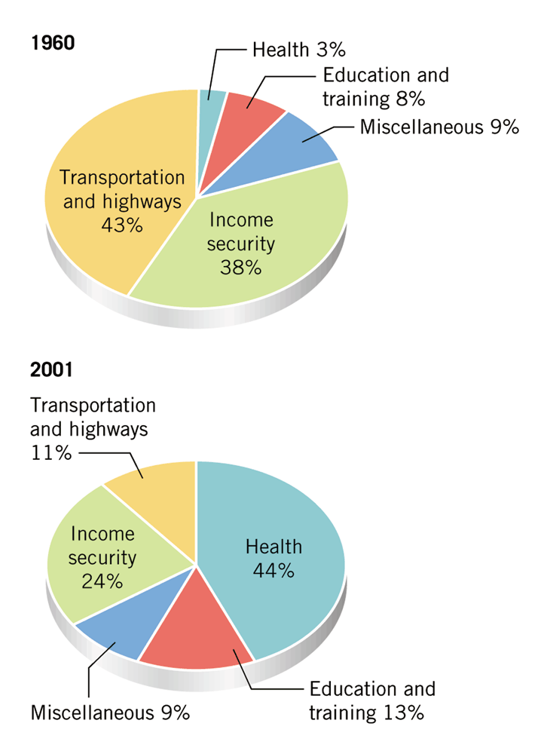
The changing purpose of federal grants…
An effect of the federal deficit is that less grant money is available to states, resulting in unfunded mandates and program cuts.
Unfunded mandates are federal regulations which states must implement at the state’s cost. For example, air and pollution clean ups, implementation of the Americans with Disabilities Act.

